Slide 1

Probabilities and Markov Models
Read AIMA Chapter 15 “Probabilistic Reasoning Over time” (15.1-15.5)

Slide 2
Review: Uncertainty
General situation:
Observed variables (evidence): Agent knows certain things about the state of the world (e.g., sensor readings or symptoms)
Unobserved variables (states): Agent needs to reason about other aspects (e.g. where an object is or what disease is present)
Model: Agent knows something about how the known variables relate to the unknown variables
Probabilistic reasoning gives us a framework for managing our beliefs and knowledge
Notes:
Consider the following example: You are the security guard stationed at a secret underground installation. You want to know whether it’s raining today, but your only access to the outside world occurs each morning when you see the director coming in with, or without, an umbrella. For each day t, the set Et thus contains a single evidence variable Umbrellat or Ut for short (whether the umbrella appears), and the set Xt contains a single state variable Raint or Rt for short (whether it is raining).

Slide 3
Review: Random Variables
A random variable is some aspect of the world about which we (may) have uncertainty
R = Is it raining?
U = Is the director carrying an umbrella?
We denote random variables with capital letters
Notes:
We are going to deal with discrete random variables, rather than continuous ones. In continuous you deal with integrals rather than summations.

Slide 4
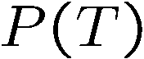
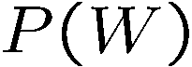

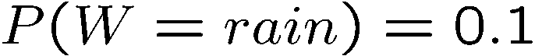
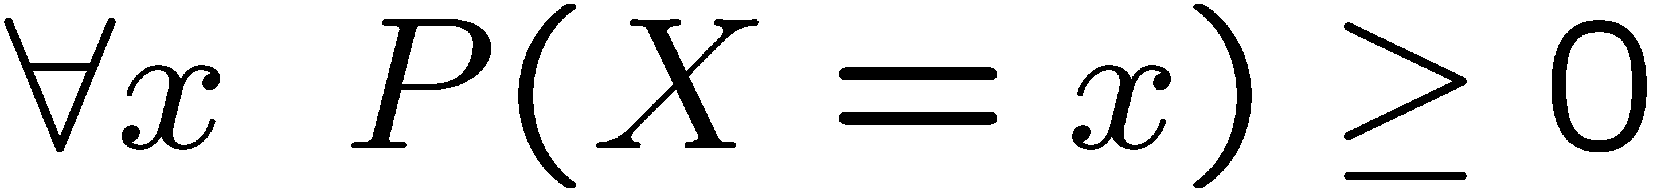
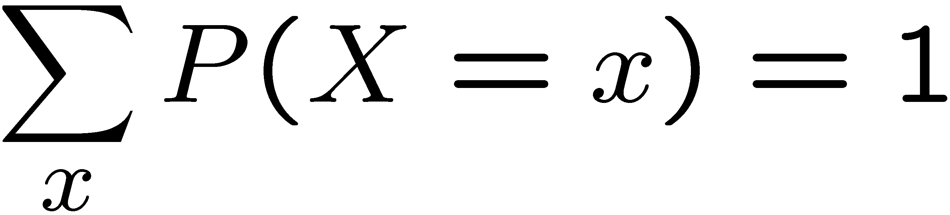
Review: Probability Distributions
Unobserved random variables have distributions
A distribution is a TABLE of probabilities of values
A probability (lower case value) is a single number
Must have: and
Shorthand notation:
OK if all domain entries are unique
T | P
hot | 0.5
cold | 0.5
W | P
sun | 0.6
rain | 0.1
fog | 0.3

Slide 5
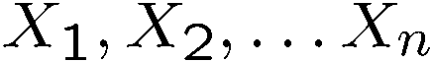
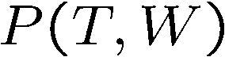
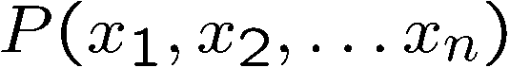
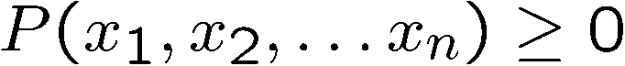
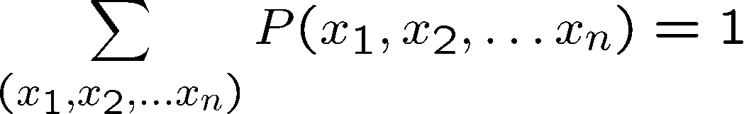
Review: Joint Distributions
A joint distribution over a set of random variables:
specifies a real number for each assignment (or outcome):
Must obey:
Size of distribution if n variables with domain sizes d?
For all but the smallest distributions, impractical to write out!
T | W | P
hot | sun | 0.4
hot | rain | 0.1
cold | sun | 0.2
cold | rain | 0.3
Notes:
N*D? No.
D^N? Yes.
In the next lectures we’re going to see how to work with how to deal with large sets of variables.

Slide 6
Review: Probabilistic Models
Distribution over T,W
A probabilistic model is a joint distribution over a set of random variables
Probabilistic models:
(Random) variables with domains
Assignments are called outcomes
Joint distributions: say whether assignments (outcomes) are likely
Normalized: sum to 1.0
Ideally: only certain variables directly interact
T | W | P
hot | sun | 0.4
hot | rain | 0.1
cold | sun | 0.2
cold | rain | 0.3

Slide 7
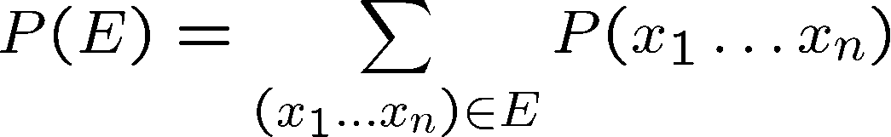
Review: Events
An event is a set E of outcomes
From a joint distribution, we can calculate the probability of any event
Probability that it’s hot AND sunny?
Probability that it’s hot?
Probability that it’s hot OR sunny?
Typically, the events we care about are partial assignments, like P(T=hot)
T | W | P
hot | sun | 0.4
hot | rain | 0.1
cold | sun | 0.2
cold | rain | 0.3
Notes:
An event is a set of possible outcomes. We compute these by summing over all subsets of variables that are compatible with that event. These are subsets of variables.
Let’s say x1=true, then if you sum over all entries in the joint table with x1…xN, where the entry says x=1 is true then you get the probability that x=1 true.
Events don’t have to be as simple as x1=true. It could be x1=true and x2=false. Or more combinations of variables coule be involved.
Look at all of the entries that are consistent with the event.
Probability that it’s hot AND sunny? 0.4
Probability that it’s hot? 0.5
Probability that it’s hot OR sunny? 0.2

Slide 8
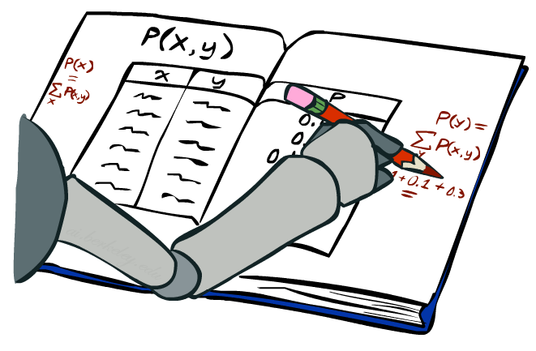
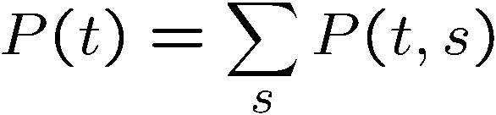
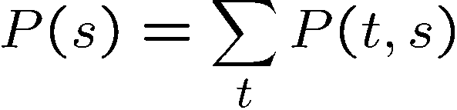
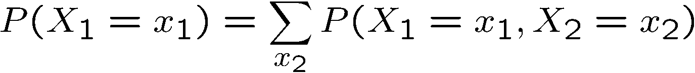
Review: Marginal Distributions
Marginal distributions are sub-tables which eliminate variables
Marginalization (summing out): Combine collapsed rows by adding
T | P
hot | 0.5
cold | 0.5
T | W | P
hot | sun | 0.4
hot | rain | 0.1
cold | sun | 0.2
cold | rain | 0.3
W | P
sun | 0.6
rain | 0.4
Notes:
Marginalize distribution means you build a new table for a subset of random variables.
This is the general equation. You can apply it to any number of random variables. If you had 3 random varaibles, you could compute the marginals for
Just x1
Just x2
Just x3
x1 and x2
x2 and x3
x1 and x3

Slide 9
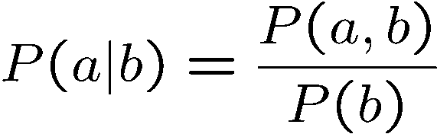
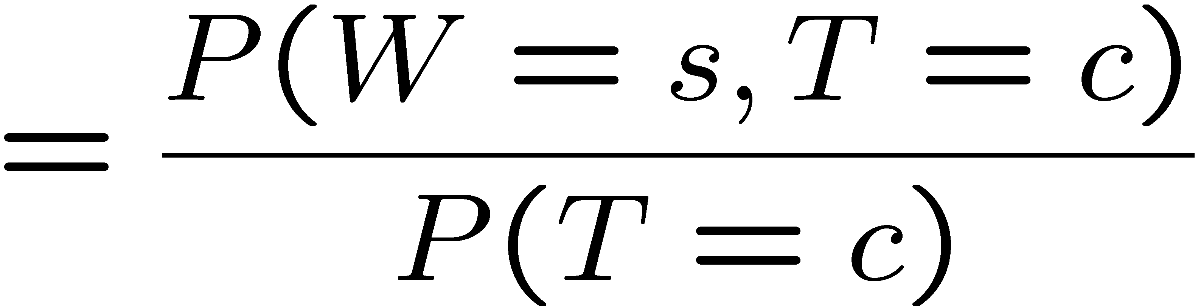
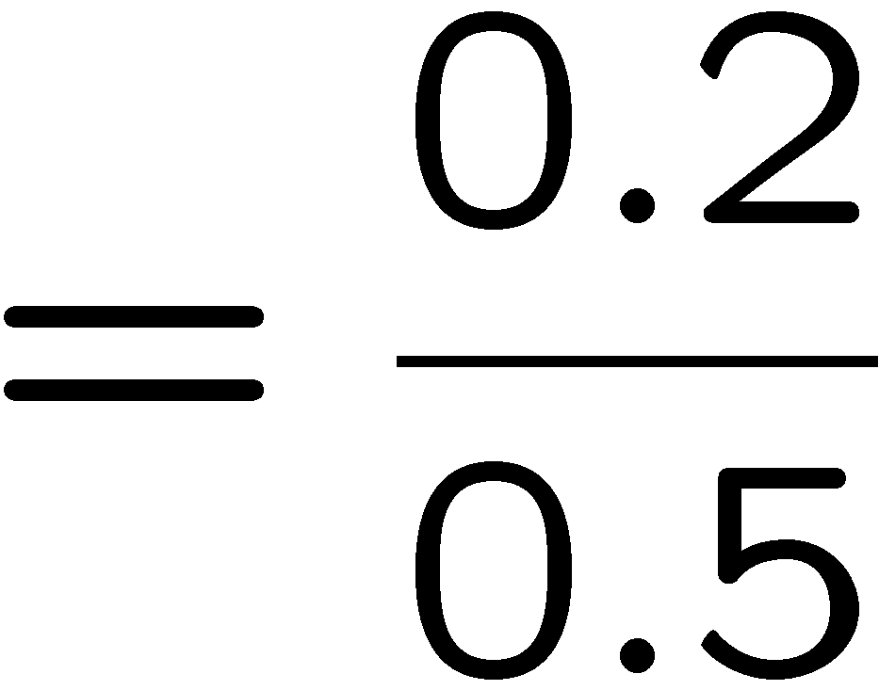



Review: Conditional Probabilities
A simple relation between joint and conditional probabilities
In fact, this is taken as the definition of a conditional probability
P(a,b)
P(a)
P(b)
T | W | P
hot | sun | 0.4
hot | rain | 0.1
cold | sun | 0.2
cold | rain | 0.3
Notes:
This is the most important concept. Why because it tells us, if we measure something, what does it tell us about the things that we didn’t get to measure. That’s what conditional probabilities come in.
A conditional probability that random variable Capital A will take on value lowercase a, given that random variable Capital B takes on value lowercase b. This is given by the probability of seeing both a and b, divided by the probability of seeing b.
[Explain the Venn diagram.]
Write out the equation for P(sun|cold)

Slide 10
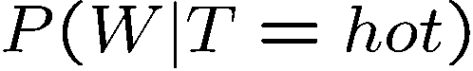
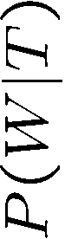
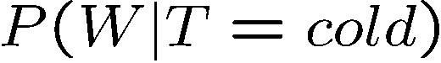
Review: Conditional Distributions
Conditional distributions are probability distributions over some variables given fixed values of others
Conditional Distributions
Joint Distribution
W | P
sun | 0.8
rain | 0.2
T | W | P
hot | sun | 0.4
hot | rain | 0.1
cold | sun | 0.2
cold | rain | 0.3
W | P
sun | 0.4
rain | 0.6
Notes:
Before we saw how to go from a joint distribution to a marginal distribution. Now we’re going to see how to go from a joint distribution to a conditional.
A conditional distribution is a consequence of the joint distribution. We do that just like we did on the previous slide).
P(W|T) is a set of tables that can be extracted from the joint distribution P(T, W).

Slide 11

Review: Probabilistic Inference
Probabilistic inference: compute a desired probability from other known probabilities (e.g. conditional from joint)
We generally compute conditional probabilities
P(on time | no reported accidents) = 0.90
These represent the agent’s beliefs given the evidence
Probabilities change with new evidence:
P(on time | no accidents, 5 a.m.) = 0.95
P(on time | no accidents, 5 a.m., raining) = 0.80
Observing new evidence causes beliefs to be updated
Notes:
What is probabilistic inference in general? It’s computing some desired probabilities (usually conditionals), given some input set of probabilities (by default, a large joint distribution).
The reason that this is interesting, is that our probability distributions change as we accrue more evidence.
Observing new evidence causes our beliefs to be updated. Evidence can cause the probabilities to go up or to go down.

Slide 12
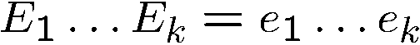
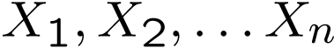
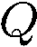
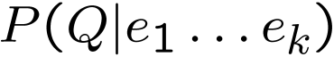
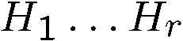
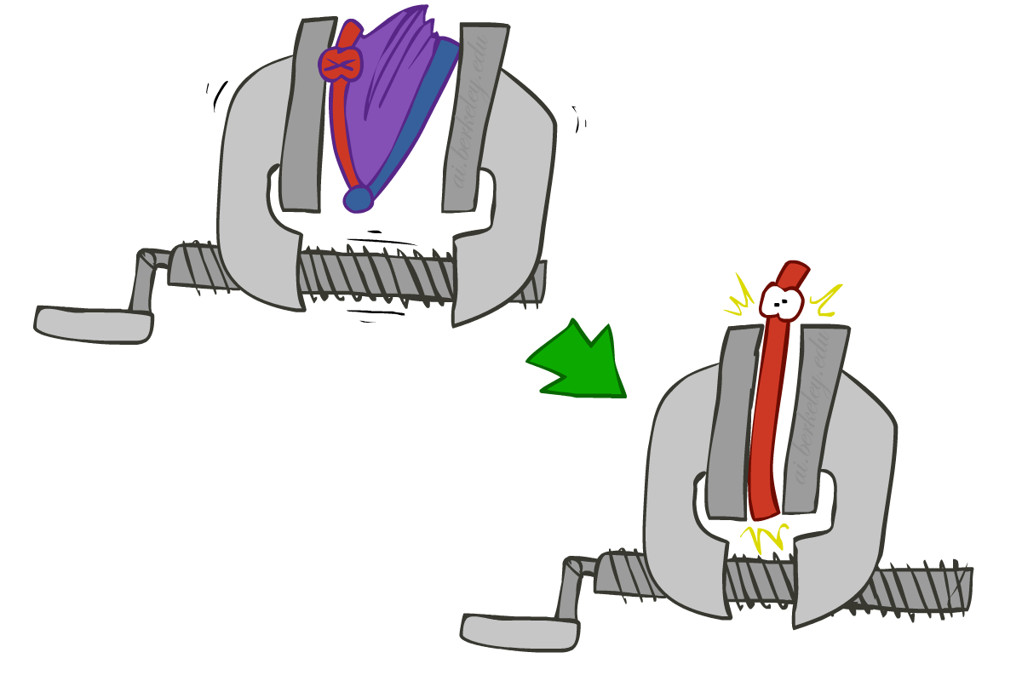
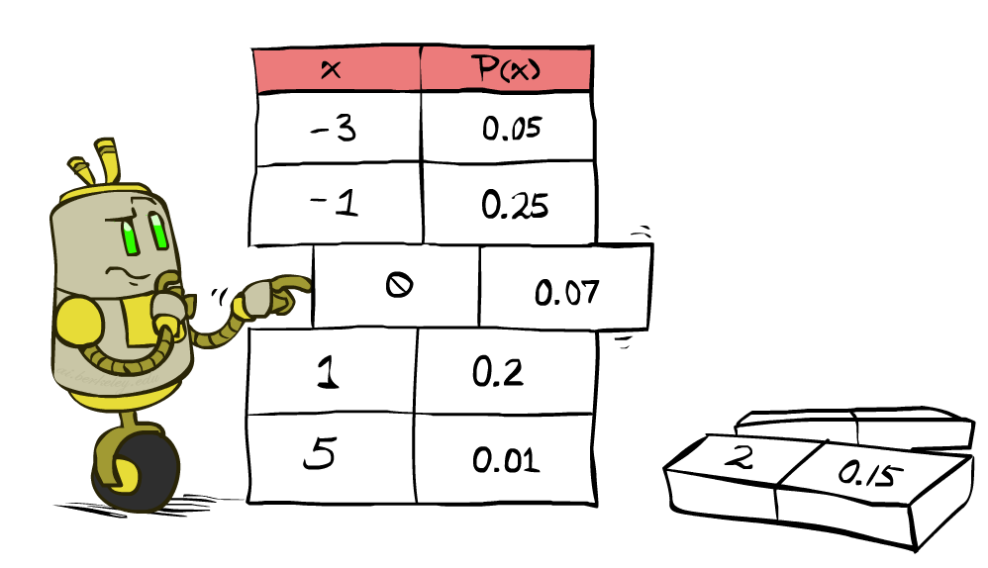
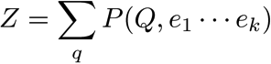
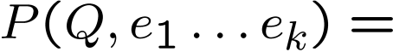
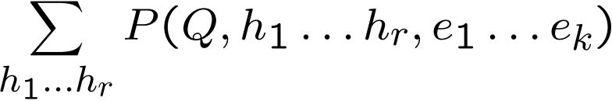
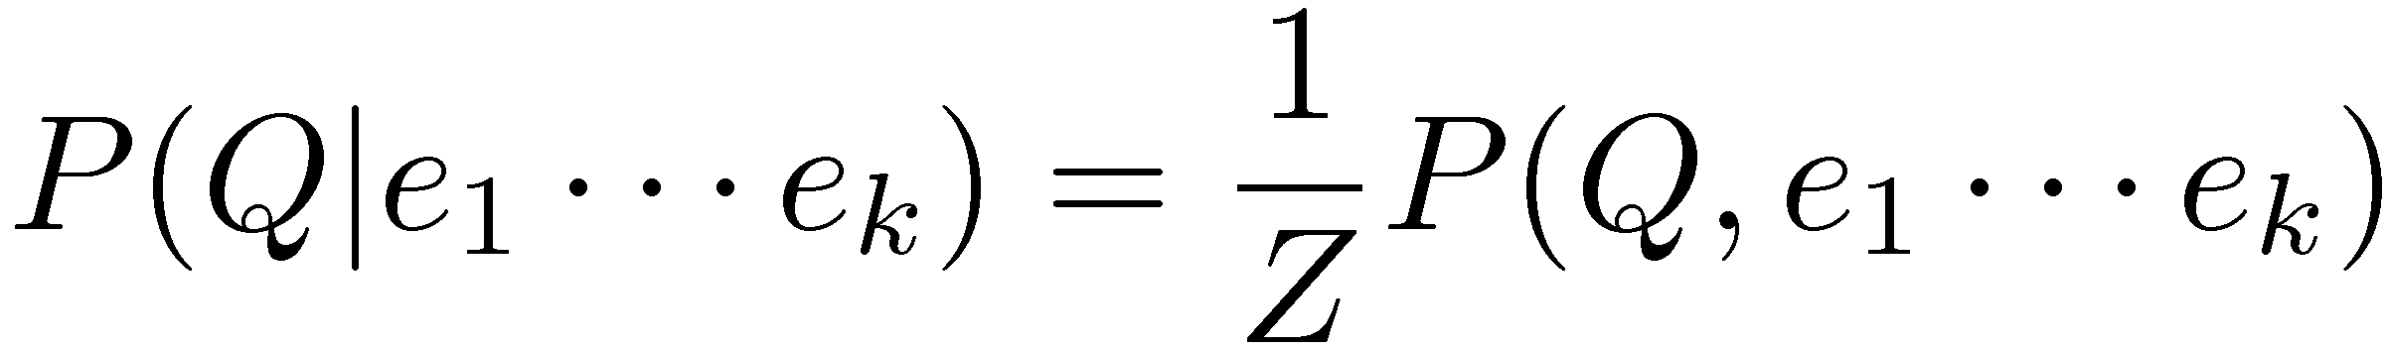
Review: Inference by Enumeration
* Works fine with multiple query variables, too
General case:
Evidence variables:
Query* variable:
Hidden variables:
We want:
All variables
Step 1: Select the entries consistent with the evidence
Step 2: Sum out H to get joint of Query and evidence
Step 3: Normalize
Notes:
Here’s the first procedure that we’ll look at for Probabilistic Inference. It is called Inference by Enumeration
We can split up our variables into 3 sets:
1. some evidence variables – those are what we’ve observed.
2. The query variables – those are what we want to know about
3. The hidden variables – those appear in the joint distribution, but don’t appear in the previous 2.
Here are the 3 steps that we need to do:
Step 1: select all entries that are consistent with the Evidence.
Step 2: Sum out the hidden variables. Sum over all possible instantiations of the hidden variables. That leaves us with the joint distribution between the query variable and the evidence variables.
That’s something like P(a, c) = sum over b P(a,b,c).
That’s the same as P(q, e) = sum over h P(q,h,e).
Step 3: Normalize to get the conditional probability.

Slide 13
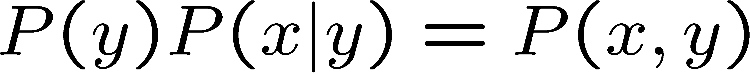
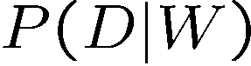
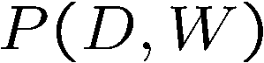
Review: The Product Rule
Example:
D | W | P
wet | sun | 0.1
dry | sun | 0.9
wet | rain | 0.7
dry | rain | 0.3
D | W | P
wet | sun | 0.08
dry | sun | 0.72
wet | rain | 0.14
dry | rain | 0.06
R | P
sun | 0.8
rain | 0.2
Notes:
How do recover the full joint distribution?
P(wet, sun) =. P(sun) * P(wet | sun) = 0.8 * 0.1 = 0.08
P(dry, sun) =. P(sun) * P(dry| sun) = 0.8 * 0.9 = 0.72
…
We can compute every entry that way.

Slide 14
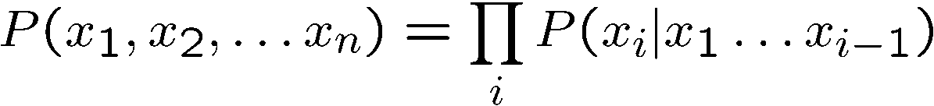
Review: The Chain Rule
More generally, can always write any joint distribution as an incremental product of conditional distributions
Why is this always true?
Notes:
Can we apply the product rule to more than two variables? Yes! It’s called the chain rule.
Here’s the chain rule for 3 variables, x1, x2, x3. It’s the maginal of x1, times the conditional of x2 given x1, times the conditional of x3 given x1 and x2.
We can generalize this to any number of x1 to x_n as ….
i = 1 P(x1)
I = 2 p(x2|x1)
I = 3 p(x3|x1, x2)
…
I = n p(x_n|x1, x2, …. Xn-1)
Then you take the product of all of those. You can take any ordering and still apply this chain rule. There are n! ways of writing the joint over the ordering of n variables.
Why is this always true? [Write out the equations for P(x1,x2,x3) replacing each conditional with its joint over marginal equivalent and show how the cancel.).
P(x1) * P(x2|x1) * p(x3|x2,x1) rewrites as P(x1) * P(x2,x1)/P(x1) * p(x3,x2,x1)/p(x2,x1).
Show the cancelation of each numerator and the next term’s denominator.
That leaves p(x3,x2,x1).
If you want, you can prove this by induction.

Slide 15
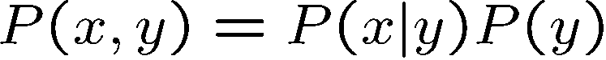
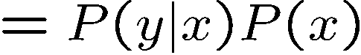
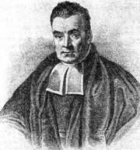
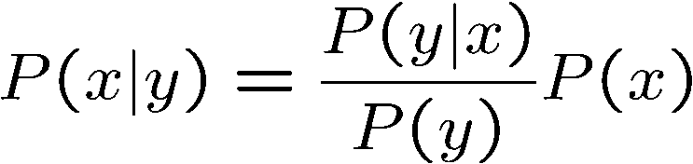
Review: Bayes’ Rule
Two ways to factor a joint distribution over two variables:
Dividing, we get:
Why is this at all helpful?
Lets us build one conditional from its reverse
Often one conditional is tricky but the other one is simple
Foundation of many systems we’ll see later (e.g. ASR, MT)
In the running for most important AI equation!
Notes:
We start with the product rule. Just like the chain rule you can write the variables in any order.
Next we divide by p(y) to get this formula for the conditional probability.
Why is this helpful? Sometimes one conditional is much trickier to get than it is to get other conditionals.
Very imporant for AI in the 1990s. In fact Fred Jelinek, my former boss at JHU, dubbed it the fundamental equation of machine translation.
Generalizations of this will be what we study in the next few lectures.

Slide 16
Review: Inference with Bayes’ Rule
Example: Diagnostic probability from causal probability:
Example:
M: meningitis, S: stiff neck
Note: posterior probability of meningitis still very small
Note: you should still get stiff necks checked out! Why?
Example
givens
Notes:
What’s the probability that meningitis is the cause, given that we have the effect of a stiff neck? The equation equation works out to be 0.007944 or a bit less than 1%.
This can be used to make decisions? Should a person with a stiff neck go to the doctor? It depends on the probabilities and the utilities. What’s the utility of living with undiagnosed meningitis? What’s the utility of knowing that you don’t have it after going to the doctor and getting a clean bill of health? What’s the utility of living without meningitis, if you go and get it treated?
The cost of undiagnosed meningitis may be high, versus the cost of going to the doctor which may just take a little bit of time.
Meningitis is an inflammation of the membranes (meninges) surrounding your brain and spinal cord.
The swelling from meningitis typically triggers symptoms such as headache, fever and a stiff neck.
Most cases of meningitis in the United States are caused by a viral infection, but bacterial, parasitic and fungal infections are other causes. Some cases of meningitis improve without treatment in a few weeks. Others can be life-threatening and require emergent antibiotic treatment.

Slide 17
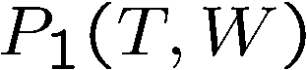
Example: Independence?
T | P
hot | 0.5
cold | 0.5
T | W | P
hot | sun | 0.4
hot | rain | 0.1
cold | sun | 0.2
cold | rain | 0.3
T | W | P
hot | sun | 0.3
hot | rain | 0.2
cold | sun | 0.3
cold | rain | 0.2
W | P
sun | 0.6
rain | 0.4

Slide 18

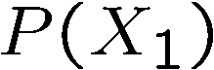
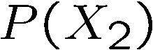
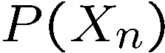
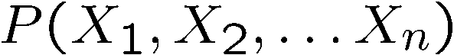

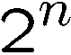
Example: Independence
N fair, independent coin flips:
H | 0.5
T | 0.5
H | 0.5
T | 0.5
H | 0.5
T | 0.5

Slide 19
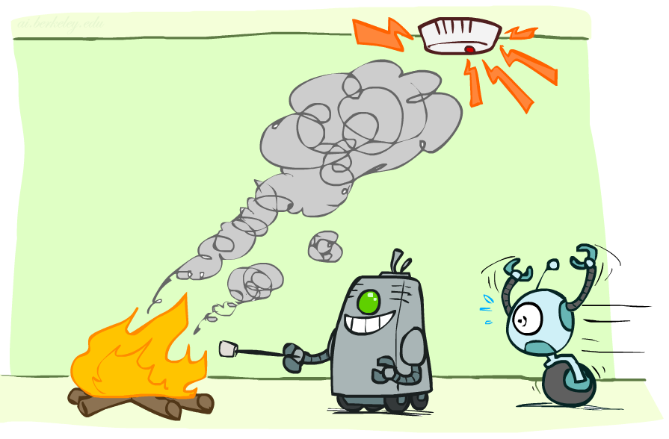
Conditional Independence

Slide 20
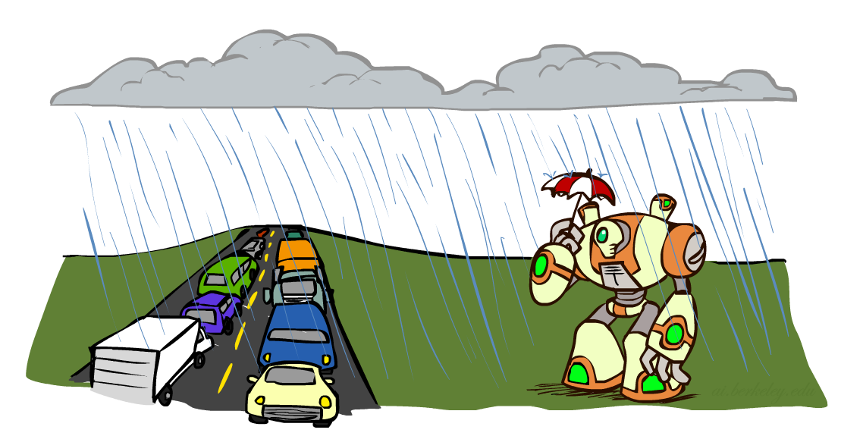
Conditional Independence
What about this domain:
Traffic
Umbrella
Raining

Slide 21

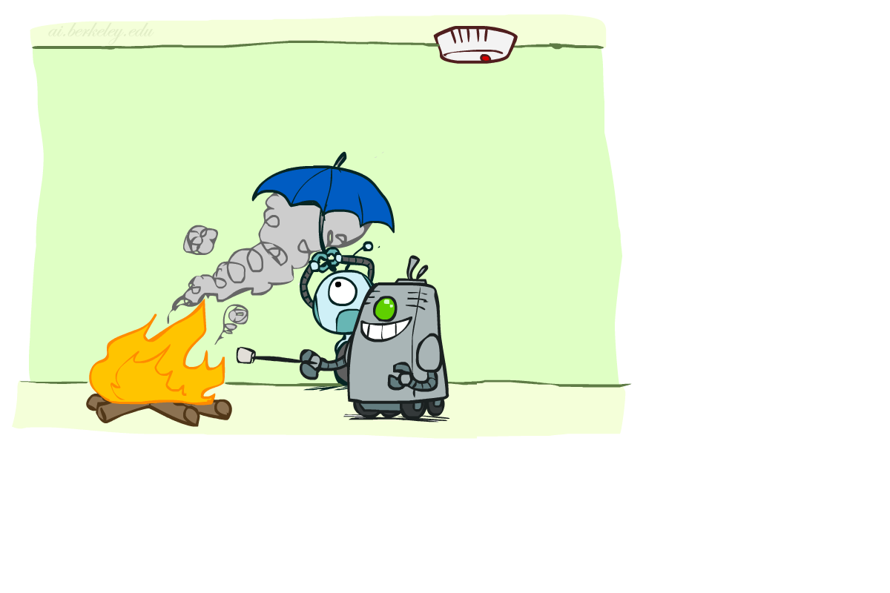
Conditional Independence
What about this domain:
Fire
Smoke
Alarm

Slide 22
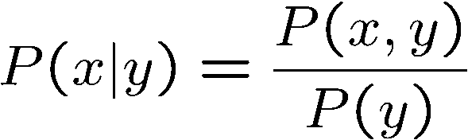


Probability Recap
Conditional probability
Product rule
Chain rule
X, Y independent if and only if:
X and Y are conditionally independent given Z if and only if:

Slide 23


Independence
Two variables are independent in a joint distribution if:
Says the joint distribution factors into a product of two simple ones
Usually variables aren’t independent!
Can use independence as a modeling assumption
Independence can be a simplifying assumption
Empirical joint distributions: at best “close” to independent
What could we assume for {Weather, Traffic, Cavity}?

Slide 24

Conditional Independence
P(Toothache, Cavity, Catch)
If I have a cavity, the probability that the probe catches in it doesn't depend on whether I have a toothache:
P(+catch | +toothache, +cavity) = P(+catch | +cavity)
The same independence holds if I don’t have a cavity:
P(+catch | +toothache, -cavity) = P(+catch| -cavity)
Catch is conditionally independent of Toothache given Cavity:
P(Catch | Toothache, Cavity) = P(Catch | Cavity)
Equivalent statements:
P(Toothache | Catch , Cavity) = P(Toothache | Cavity)
P(Toothache, Catch | Cavity) = P(Toothache | Cavity) P(Catch | Cavity)
One can be derived from the other

Slide 25

Conditional Independence
Unconditional (absolute) independence very rare (why?)
Conditional independence is our most basic and robust form of knowledge about uncertain environments.
X is conditionally independent of Y given Z
if and only if:
or, equivalently, if and only if

Slide 26
Probabilistic Reasoning Over Time
Read AIMA Chapter 15 (15.1-15.5)
These slides are courtesy of Dan Klein and Pieter Abbeel for UC Berkeley’s Intro to AI course

Slide 27
Partially Observable Environments
So far, we have considered full-observable environments like chess, or gridworld
In partially-observable environments we don’t see everything
In this case an agent needs to maintain a belief state that represents represents which states are currently possible
Notes:
﻿Agents in partially observable environments must be able to keep track of the current state, to the extent that their sensors allow. In Section 4.4 we showed a methodology for doing that: an agent maintains a belief state that represents which states of the world are currently possible. From the belief state and a transition model, the agent can predict how the world might evolve in the next time step. From the percepts observed and a sensor model, the agent can update the belief state. This is a pervasive idea: in Chapter 4 belief states were represented by explicitly enumerated sets of states, whereas in Chapters 7 and 11 they were represented by logical formulas. Those approaches defined belief states in terms of which world states were possible, but could say nothing about which states were likely or unlikely. In this chapter, we use probability theory to quantify the degree of belief in elements of the belief state. As we show in Section 15.1, time itself is handled in the same way as in Chapter 7: a changing world is modeled using a variable for each aspect of the world state at each point in time. The transition and sensor models may be uncertain: the transition model describes the probability distribution of the variables at time t, given the state of the world at past times, while the sensor model describes the probability of each percept at time t, given the current state of the world. Section 15.2 defines the basic inference tasks and describes the general structure of inference algorithms for temporal models. Then we describe three specific kinds of models: hidden Markov models, Kalman filters, and dynamic Bayesian networks (which include hidden Markov models and Kalman filters as special cases). Finally, Section 15.6 examines the problems faced when keeping track of more than one thing. Russell, Stuart. Artificial Intelligence (p. 566). Pearson Education. Kindle Edition.

Slide 28

Robot Localization
Given a map and sensor data, the robot updates its beliefs about where it is.
Sensor data with one observation saying there are obstacles to the North, South and West.

Slide 29

Robot Localization
Given a map and sensor data, the robot updates its beliefs about where it is.
Sensor data with one observation saying there are obstacles to the North, South and West. The robot moves, and then takes another observation with obstacles to the North and South, and updates its belief state.

Slide 30
Reasoning over Time or Space
Often, we want to reason about a sequence of observations
Robot localization
Speech recognition
Medical monitoring
Need to introduce time (or space) into our models

Slide 31


Markov Models
Value of X at a given time is called the state
Parameters: called transition probabilities or dynamics, specify how the state evolves over time (also, initial state probabilities)
Stationarity assumption: transition probabilities the same at all times
Same as MDP transition model, but no choice of action
X₁
X₂
X₃
X₄

Slide 32
Joint Distribution of a Markov Model
X₁
X₂
X₃
X₄
Joint distribution:
More generally:
Questions to be resolved:
Does this indeed define a joint distribution?
Can every joint distribution be factored this way, or are we making some assumptions about the joint distribution by using this factorization?

Slide 33
Chain Rule and Markov Models
X₁
X₂
X₃
X₄
From the chain rule, every joint distribution over can be written as:
Assuming that
and
results in the expression posited on the previous slide:

Slide 34
Chain Rule and Markov Models
X₁
X₂
X₃
X₄
From the chain rule, every joint distribution over can be written as:
Assuming that for all t:
gives us the expression posited on the earlier slide:

Slide 35
Markov Models Recap
Explicit assumption for all t :
Consequence, joint distribution can be written as:
Implied conditional independencies: (try to prove this!)
Past variables independent of future variables given the present
i.e., if or then:
Additional explicit assumption: is the same for all t

Slide 36

Conditional Independence
Basic conditional independence:
Past and future independent of the present
Each time step only depends on the previous
This is called the (first order) Markov property
Note that the chain is just a (growable) BN
We can always use generic BN reasoning on it if we truncate the chain at a fixed length

Slide 37

Example Markov Chain: Weather
States: X = {rain, sun}
Initial distribution: 1.0 sun
CPT P(X_{t} | X_{t-1}):
Two new ways of representing the same CPT
X_{t-1} | X_{t} | P(X_{t}|X_{t-1})
sun | sun | 0.9
sun | rain | 0.1
rain | sun | 0.3
rain | rain | 0.7
0.9
0.3
0.9
rain
sun
sun
sun
0.1
0.3
rain
rain
0.7
0.7
0.1

Slide 38
Example Markov Chain: Weather
0.9
Initial distribution: 1.0 sun
What is the probability distribution after one step?
0.3
rain
sun
0.7
0.1

Slide 39


Mini-Forward Algorithm
Question: What’s P(X) on some day t?
X₁
X₂
X₃
X₄
Forward simulation

Slide 40










Example Run of Mini-Forward Algorithm
From initial observation of sun
From initial observation of rain
From yet another initial distribution P(X₁):
P(X₁)
P(X₂)
P(X₃)
P(X₄)
P(X∞)
P(X₁)
P(X₂)
P(X₃)
P(X₄)
P(X∞)
…
P(X₁)
P(X∞)
[Demo: L13D1,2,3]

Slide 41

Video of Demo Ghostbusters Basic Dynamics

Slide 42
Video of Demo Ghostbusters Circular Dynamics

Slide 43
Video of Demo Ghostbusters Whirlpool Dynamics

Slide 44
Stationary Distributions
For most chains:
Influence of the initial distribution gets less and less over time.
The distribution we end up in is independent of the initial distribution
Stationary distribution:
The distribution we end up with is called the stationary distribution of the chain
It satisfies

Slide 45
Example: Stationary Distributions
Question: What’s P(X) at time t = infinity?
X₁
X₂
X₃
X₄
X_{t-1} | X_{t} | P(X_{t}|X_{t-1})
sun | sun | 0.9
sun | rain | 0.1
rain | sun | 0.3
rain | rain | 0.7
Also:

Slide 46

Application of Stationary Distribution: Web Link Analysis
PageRank over a web graph
Each web page is a state
Initial distribution: uniform over pages
Transitions:
With prob. c, uniform jump to a
random page (dotted lines, not all shown)
With prob. 1-c, follow a random
outlink (solid lines)
Stationary distribution
Will spend more time on highly reachable pages
E.g. many ways to get to the Acrobat Reader download page
Somewhat robust to link spam
Google 1.0 returned the set of pages containing all your keywords in decreasing rank, now all search engines use link analysis along with many other factors (rank actually getting less important over time)
Notes:
Before: most search engines were merely based on how well a page matches your search words.
Note: currently dominated by clickstreams

Slide 47

Application of Stationary Distributions: Gibbs Sampling*
Each joint instantiation over all hidden and query variables is a state: {X₁, …, X_{n}} = H U Q
Transitions:
With probability 1/n resample variable X_{j} according to
P(X_{j} | x₁, x₂, …, x_{j-1,} x_{j+1}, …, x_{n,} e_{1,} …, e_{m})
Stationary distribution:
Conditional distribution P(X₁, X₂ , … , X_{n}|e_{1,} …, e_{m})
Means that when running Gibbs sampling long enough we get a sample from the desired distribution
Requires some proof to show this is true!
Notes:
With re-ordering of topics, can’t cover this here yet, need to wait till after sampling.

Slide 48
Next Up: Markov Models for NLP

Slide 49
Probabilities and Markov Models
Read AIMA Chapter 15 “Probabilistic Reasoning Over time” (15.1-15.5)

Slide 50
Review: Uncertainty
General situation:
Observed variables (evidence): Agent knows certain things about the state of the world (e.g., sensor readings or symptoms)
Unobserved variables (states): Agent needs to reason about other aspects (e.g. where an object is or what disease is present)
Model: Agent knows something about how the known variables relate to the unknown variables
Probabilistic reasoning gives us a framework for managing our beliefs and knowledge
Notes:
﻿Consider the following example: You are the security guard stationed at a secret underground installation. You want to know whether it’s raining today, but your only access to the outside world occurs each morning when you see the director coming in with, or without, an umbrella. For each day t, the set Et thus contains a single evidence variable Umbrellat or Ut for short (whether the umbrella appears), and the set Xt contains a single state variable Raint or Rt for short (whether it is raining).

Slide 51
Review: Random Variables
A random variable is some aspect of the world about which we (may) have uncertainty
R = Is it raining?
U = Is the director carrying an umbrella?
We denote random variables with capital letters
Like variables in a CSP, random variables have domains
R in {true, false} (often write as {+r, -r})
T in {hot, cold}
D in [0, ∞)
L in possible locations, maybe {(0,0), (0,1), …}
Notes:
We are going to deal with discrete random variables, rather than continuous ones. In continuous you deal with integrals rather than summations.

Slide 52
Review: Probability Distributions
Unobserved random variables have distributions
A distribution is a TABLE of probabilities of values
A probability (lower case value) is a single number
Must have: and
Shorthand notation:
OK if all domain entries are unique
T | P
hot | 0.5
cold | 0.5
W | P
sun | 0.6
rain | 0.1
fog | 0.3

Slide 53
Review: Joint Distributions
A joint distribution over a set of random variables:
specifies a real number for each assignment (or outcome):
Must obey:
Size of distribution if n variables with domain sizes d?
For all but the smallest distributions, impractical to write out!
T | W | P
hot | sun | 0.4
hot | rain | 0.1
cold | sun | 0.2
cold | rain | 0.3
Notes:
N*D? No.
D^N? Yes.
In the next lectures we’re going to see how to work with how to deal with large sets of variables.

Slide 54
Review: Probabilistic Models
Distribution over T,W
A probabilistic model is a joint distribution over a set of random variables
Probabilistic models:
(Random) variables with domains
Assignments are called outcomes
Joint distributions: say whether assignments (outcomes) are likely
Normalized: sum to 1.0
Ideally: only certain variables directly interact
T | W | P
hot | sun | 0.4
hot | rain | 0.1
cold | sun | 0.2
cold | rain | 0.3

Slide 55
Review: Events
An event is a set E of outcomes
From a joint distribution, we can calculate the probability of any event
Probability that it’s hot AND sunny?
Probability that it’s hot?
Probability that it’s hot OR sunny?
Typically, the events we care about are partial assignments, like P(T=hot)
T | W | P
hot | sun | 0.4
hot | rain | 0.1
cold | sun | 0.2
cold | rain | 0.3
Notes:
An event is a set of possible outcomes. We compute these by summing over all subsets of variables that are compatible with that event. These are subsets of variables.
Let’s say x1=true, then if you sum over all entries in the joint table with x1…xN, where the entry says x=1 is true then you get the probability that x=1 true.
Events don’t have to be as simple as x1=true. It could be x1=true and x2=false. Or more combinations of variables coule be involved.
Look at all of the entries that are consistent with the event.
Probability that it’s hot AND sunny? 0.4
Probability that it’s hot? 0.5
Probability that it’s hot OR sunny? 0.2

Slide 56
Review: Marginal Distributions
Marginal distributions are sub-tables which eliminate variables
Marginalization (summing out): Combine collapsed rows by adding
T | P
hot | 0.5
cold | 0.5
T | W | P
hot | sun | 0.4
hot | rain | 0.1
cold | sun | 0.2
cold | rain | 0.3
W | P
sun | 0.6
rain | 0.4
Notes:
Marginalize distribution means you build a new table for a subset of random variables.
This is the general equation. You can apply it to any number of random variables. If you had 3 random varaibles, you could compute the marginals for
Just x1
Just x2
Just x3
x1 and x2
x2 and x3
x1 and x3

Slide 57
Review: Conditional Probabilities
A simple relation between joint and conditional probabilities
In fact, this is taken as the definition of a conditional probability
P(a,b)
P(a)
P(b)
T | W | P
hot | sun | 0.4
hot | rain | 0.1
cold | sun | 0.2
cold | rain | 0.3
Notes:
This is the most important concept. Why because it tells us, if we measure something, what does it tell us about the things that we didn’t get to measure. That’s what conditional probabilities come in.
A conditional probability that random variable Capital A will take on value lowercase a, given that random variable Capital B takes on value lowercase b. This is given by the probability of seeing both a and b, divided by the probability of seeing b.
[Explain the Venn diagram.]
Write out the equation for P(sun|cold)

Slide 58
Review: Conditional Distributions
Conditional distributions are probability distributions over some variables given fixed values of others
Conditional Distributions
Joint Distribution
W | P
sun | 0.8
rain | 0.2
T | W | P
hot | sun | 0.4
hot | rain | 0.1
cold | sun | 0.2
cold | rain | 0.3
W | P
sun | 0.4
rain | 0.6
Notes:
Before we saw how to go from a joint distribution to a marginal distribution. Now we’re going to see how to go from a joint distribution to a conditional.
A conditional distribution is a consequence of the joint distribution. We do that just like we did on the previous slide).
P(W|T) is a set of tables that can be extracted from the joint distribution P(T, W).

Slide 59
Review: Probabilistic Inference
Probabilistic inference: compute a desired probability from other known probabilities (e.g. conditional from joint)
We generally compute conditional probabilities
P(on time | no reported accidents) = 0.90
These represent the agent’s beliefs given the evidence
Probabilities change with new evidence:
P(on time | no accidents, 5 a.m.) = 0.95
P(on time | no accidents, 5 a.m., raining) = 0.80
Observing new evidence causes beliefs to be updated
Notes:
What is probabilistic inference in general? It’s computing some desired probabilities (usually conditionals), given some input set of probabilities (by default, a large joint distribution).
The reason that this is interesting, is that our probability distributions change as we accrue more evidence.
Observing new evidence causes our beliefs to be updated. Evidence can cause the probabilities to go up or to go down.

Slide 60
Review: Inference by Enumeration
* Works fine with multiple query variables, too
General case:
Evidence variables:
Query* variable:
Hidden variables:
We want:
All variables
Step 1: Select the entries consistent with the evidence
Step 2: Sum out H to get joint of Query and evidence
Step 3: Normalize
Notes:
Here’s the first procedure that we’ll look at for Probabilistic Inference. It is called Inference by Enumeration
We can split up our variables into 3 sets:
1. some evidence variables – those are what we’ve observed.
2. The query variables – those are what we want to know about
3. The hidden variables – those appear in the joint distribution, but don’t appear in the previous 2.
Here are the 3 steps that we need to do:
Step 1: select all entries that are consistent with the Evidence.
Step 2: Sum out the hidden variables. Sum over all possible instantiations of the hidden variables. That leaves us with the joint distribution between the query variable and the evidence variables.
That’s something like P(a, c) = sum over b P(a,b,c).
That’s the same as P(q, e) = sum over h P(q,h,e).
Step 3: Normalize to get the conditional probability.

Slide 61
Review: The Product Rule
Example:
D | W | P
wet | sun | 0.1
dry | sun | 0.9
wet | rain | 0.7
dry | rain | 0.3
D | W | P
wet | sun | 0.08
dry | sun | 0.72
wet | rain | 0.14
dry | rain | 0.06
R | P
sun | 0.8
rain | 0.2
Notes:
How do recover the full joint distribution?
P(wet, sun) =. P(sun) * P(wet | sun) = 0.8 * 0.1 = 0.08
P(dry, sun) =. P(sun) * P(dry| sun) = 0.8 * 0.9 = 0.72
…
We can compute every entry that way.

Slide 62
Review: The Chain Rule
More generally, can always write any joint distribution as an incremental product of conditional distributions
Why is this always true?
Notes:
Can we apply the product rule to more than two variables? Yes! It’s called the chain rule.
Here’s the chain rule for 3 variables, x1, x2, x3. It’s the maginal of x1, times the conditional of x2 given x1, times the conditional of x3 given x1 and x2.
We can generalize this to any number of x1 to x_n as ….
i = 1 P(x1)
I = 2 p(x2|x1)
I = 3 p(x3|x1, x2)
…
I = n p(x_n|x1, x2, …. Xn-1)
Then you take the product of all of those. You can take any ordering and still apply this chain rule. There are n! ways of writing the joint over the ordering of n variables.
Why is this always true? [Write out the equations for P(x1,x2,x3) replacing each conditional with its joint over marginal equivalent and show how the cancel.).
P(x1) * P(x2|x1) * p(x3|x2,x1) rewrites as P(x1) * P(x2,x1)/P(x1) * p(x3,x2,x1)/p(x2,x1).
Show the cancelation of each numerator and the next term’s denominator.
That leaves p(x3,x2,x1).
If you want, you can prove this by induction.

Slide 63
Review: Bayes’ Rule
Two ways to factor a joint distribution over two variables:
Dividing, we get:
Why is this at all helpful?
Lets us build one conditional from its reverse
Often one conditional is tricky but the other one is simple
Foundation of many systems we’ll see later (e.g. ASR, MT)
In the running for most important AI equation!
Notes:
We start with the product rule. Just like the chain rule you can write the variables in any order.
Next we divide by p(y) to get this formula for the conditional probability.
Why is this helpful? Sometimes one conditional is much trickier to get than it is to get other conditionals.
Very imporant for AI in the 1990s. In fact Fred Jelinek, my former boss at JHU, dubbed it the fundamental equation of machine translation.
Generalizations of this will be what we study in the next few lectures.

Slide 64
Review: Inference with Bayes’ Rule
Example: Diagnostic probability from causal probability:
Example:
M: meningitis, S: stiff neck
Note: posterior probability of meningitis still very small
Note: you should still get stiff necks checked out! Why?
Example
givens
Notes:
What’s the probability that meningitis is the cause, given that we have the effect of a stiff neck? The equation equation works out to be 0.007944 or a bit less than 1%.
This can be used to make decisions? Should a person with a stiff neck go to the doctor? It depends on the probabilities and the utilities. What’s the utility of living with undiagnosed meningitis? What’s the utility of knowing that you don’t have it after going to the doctor and getting a clean bill of health? What’s the utility of living without meningitis, if you go and get it treated?
The cost of undiagnosed meningitis may be high, versus the cost of going to the doctor which may just take a little bit of time.
Meningitis is an inflammation of the membranes (meninges) surrounding your brain and spinal cord.
The swelling from meningitis typically triggers symptoms such as headache, fever and a stiff neck.
Most cases of meningitis in the United States are caused by a viral infection, but bacterial, parasitic and fungal infections are other causes. Some cases of meningitis improve without treatment in a few weeks. Others can be life-threatening and require emergent antibiotic treatment.

Slide 65
Example: Independence?
T | P
hot | 0.5
cold | 0.5
T | W | P
hot | sun | 0.4
hot | rain | 0.1
cold | sun | 0.2
cold | rain | 0.3
T | W | P
hot | sun | 0.3
hot | rain | 0.2
cold | sun | 0.3
cold | rain | 0.2
W | P
sun | 0.6
rain | 0.4

Slide 66
Example: Independence
N fair, independent coin flips:
H | 0.5
T | 0.5
H | 0.5
T | 0.5
H | 0.5
T | 0.5

Slide 67
Conditional Independence

Slide 68
Conditional Independence
What about this domain:
Traffic
Umbrella
Raining

Slide 69
Conditional Independence
What about this domain:
Fire
Smoke
Alarm

Slide 70
Probability Recap
Conditional probability
Product rule
Chain rule
X, Y independent if and only if:
X and Y are conditionally independent given Z if and only if:

Slide 71
Independence
Two variables are independent in a joint distribution if:
Says the joint distribution factors into a product of two simple ones
Usually variables aren’t independent!
Can use independence as a modeling assumption
Independence can be a simplifying assumption
Empirical joint distributions: at best “close” to independent
What could we assume for {Weather, Traffic, Cavity}?

Slide 72
Conditional Independence
P(Toothache, Cavity, Catch)
If I have a cavity, the probability that the probe catches in it doesn't depend on whether I have a toothache:
P(+catch | +toothache, +cavity) = P(+catch | +cavity)
The same independence holds if I don’t have a cavity:
P(+catch | +toothache, -cavity) = P(+catch| -cavity)
Catch is conditionally independent of Toothache given Cavity:
P(Catch | Toothache, Cavity) = P(Catch | Cavity)
Equivalent statements:
P(Toothache | Catch , Cavity) = P(Toothache | Cavity)
P(Toothache, Catch | Cavity) = P(Toothache | Cavity) P(Catch | Cavity)
One can be derived from the other

Slide 73
Conditional Independence
Unconditional (absolute) independence very rare (why?)
Conditional independence is our most basic and robust form of knowledge about uncertain environments.
X is conditionally independent of Y given Z
if and only if:
or, equivalently, if and only if

Slide 74
Probabilistic Reasoning Over Time
Read AIMA Chapter 15 (15.1-15.5)
Some of these slides are courtesy of Dan Klein and Pieter Abbeel for UC Berkeley’s Intro to AI course

Slide 75
Partially Observable Environments
So far, we have considered full-observable environments like chess, or grid world
In partially-observable environments we don’t see everything
In this case an agent needs to maintain a belief state that represents represents which states are currently possible
Notes:
﻿Agents in partially observable environments must be able to keep track of the current state, to the extent that their sensors allow. In Section 4.4 we showed a methodology for doing that: an agent maintains a belief state that represents which states of the world are currently possible. From the belief state and a transition model, the agent can predict how the world might evolve in the next time step. From the percepts observed and a sensor model, the agent can update the belief state. This is a pervasive idea: in Chapter 4 belief states were represented by explicitly enumerated sets of states, whereas in Chapters 7 and 11 they were represented by logical formulas. Those approaches defined belief states in terms of which world states were possible, but could say nothing about which states were likely or unlikely. In this chapter, we use probability theory to quantify the degree of belief in elements of the belief state. As we show in Section 15.1, time itself is handled in the same way as in Chapter 7: a changing world is modeled using a variable for each aspect of the world state at each point in time. The transition and sensor models may be uncertain: the transition model describes the probability distribution of the variables at time t, given the state of the world at past times, while the sensor model describes the probability of each percept at time t, given the current state of the world. Section 15.2 defines the basic inference tasks and describes the general structure of inference algorithms for temporal models. Then we describe three specific kinds of models: hidden Markov models, Kalman filters, and dynamic Bayesian networks (which include hidden Markov models and Kalman filters as special cases). Finally, Section 15.6 examines the problems faced when keeping track of more than one thing. Russell, Stuart. Artificial Intelligence (p. 566). Pearson Education. Kindle Edition.

Slide 76
Robot Localization
Given a map and sensor data, the robot updates its beliefs about where it is.
Sensor data with one observation saying there are obstacles to the North, South and West.

Slide 77
Robot Localization
Given a map and sensor data, the robot updates its beliefs about where it is.
Sensor data with one observation saying there are obstacles to the North, South and West. The robot moves, and then takes another observation with obstacles to the North and South, and updates its belief state.

Slide 78
Reasoning over Time or Space
Often, we want to reason about a sequence of observations
Robot localization
Speech recognition
Medical monitoring
Need to introduce time (or space) into our models

Slide 79
Markov Models
Value of X at a given time is called the state
Parameters: called transition probabilities or dynamics, specify how the state evolves over time (also, initial state probabilities)
Stationary assumption: transition probabilities the same at all times
Same as MDP transition model, but no choice of action
X₁
X₂
X₃
X₄

Slide 80
Joint Distribution of a Markov Model
X₁
X₂
X₃
X₄
Joint distribution:
More generally:
Notes:
Questions to be resolved:
Does this indeed define a joint distribution?
Can every joint distribution be factored this way, or are we making some assumptions about the joint distribution by using this factorization?

Slide 81
Chain Rule and Markov Models
X₁
X₂
X₃
X₄
From the chain rule, every joint distribution over can be written as:
Assuming that
and
results in the expression posited on the previous slide:

Slide 82
Chain Rule and Markov Models
X₁
X₂
X₃
X₄
From the chain rule, every joint distribution over can be written as:
Assuming that for all t:
gives us the expression posited on the earlier slide:

Slide 83
Markov Models for Natural Language Processing

Slide 84

https://www.youtube.com/watch?v=M8MJFrdfGe0
Notes:
https://www.youtube.com/watch?v=M8MJFrdfGe0

Slide 85
Probabilistic Language Models
One goal: assign a probability to a sentence
Autocomplete for texting
Machine Translation
Spelling Correction
Speech Recognition
Other Natural Language Generation tasks: summarization, question-answering, dialog systems
Notes:
minuet = a slow, stately ballroom dance

Slide 86
Probabilistic Language Modeling
Goal: compute the probability of a sentence or sequence of words
Related task: probability of an upcoming word
A model that computes either of these
Better: the grammar But language model or LM is standard

Slide 87
Probabilistic Language Modeling
Goal: compute the probability of a sentence or sequence of words
P(W) = P(w₁,w₂,w₃,w₄,w₅…w_{n})
Related task: probability of an upcoming word
P(w₅|w₁,w₂,w₃,w₄)
A model that computes either of these
P(W) or P(w_{n}|w₁,w₂…w_{n-1}) is called a language model.
Better: the grammar But language model or LM is standard

Slide 88
How to compute P(W)
How to compute this joint probability:
P(the, underdog, Philadelphia, Eagles, won)
Intuition: let’s rely on the Chain Rule of Probability

Slide 89
The Chain Rule

Slide 90
The Chain Rule
Recall the definition of conditional probabilities
p(B|A) = P(A,B)/P(A) Rewriting: P(A,B) = P(A)P(B|A)
More variables:
P(A,B,C,D) = P(A)P(B|A)P(C|A,B)P(D|A,B,C)
The Chain Rule in General
P(x₁,x₂,x₃,…,x_{n}) = P(x₁)P(x₂|x₁)P(x₃|x₁,x₂)…P(x_{n}|x₁,…,x_{n-1})

Slide 91
The Chain Rule applied to compute joint probability of words in sentence

Slide 92
The Chain Rule applied to compute joint probability of words in sentence
P(“the underdog Philadelphia Eagles won”) =
P(the) × P(underdog|the) × P(Philadelphia|the underdog)
× P(Eagles|the underdog Philadelphia)
× P(won|the underdog Philadelphia Eagles)

Slide 93
How to estimate these probabilities
Could we just count and divide?

Slide 94
How to estimate these probabilities
Could we just count and divide? Maximum likelihood estimation (MLE)
Why doesn’t this work?
P(won|the underdog team) = Count(the underdog team won)
Count(the underdog team)
Notes:
Sentences may not appear
Need a lrage data set
Many ways of combining words into sentences
Never going to have enough data to estimate the probability of a whole sentence

Slide 95
Simplifying Assumption = Markov Assumption

Slide 96

Simplifying Assumption = Markov Assumption
P(won|the underdog team) $≈$ P(won|team)
Only depends on the previous k words, not the whole context
$≈$ P(won|underdog team)
$≈$P(w_{i}|w_{i-2} w_{i-1})
$\text{P}\text{(}\text{w}\text{1}\text{w}\text{2}\text{w}\text{3}\text{w}\text{4}\text{…}\text{w}\text{n}\text{)}≈\prod_{i}^{n}{\text{P}\text{(}\text{w}\text{i}\text{|}\text{w}\text{i}\text{−}\text{k}…\text{w}\text{i}\text{−1}\text{)}}$
K is the number of context words that we take into account

Slide 97

How much history should we use?
unigram | no history | $$\prod_{i}^{n}{\text{p}\text{(}w_{i}\text{)}}$$ | $$p\left(w_{i}\right)=\frac{count(w_{i})}{all words}$$
bigram | 1 word as history | $$\prod_{i}^{n}{\text{p}\text{(}w_{i}\text{|}w_{i−1}\text{)}}$$ | $$p\left(w_{i}\text{|}w_{i−1}\right)=\frac{count(w_{i−1}w_{i})}{count(w_{i−1})}$$
trigram | 2 words as history | $$\prod_{i}^{n}{\text{p}\text{(}w_{i}\text{|}w_{i−2}w_{i−1}\text{)}}$$ | $$p\left(w_{i}\text{|}w_{i−2}w_{i−1}\right)=\frac{count(w_{i−2}w_{i−1}w_{i})}{count({w_{i−2}w}_{i−1})}$$
4-gram | 3 words as history | $$\prod_{i}^{n}{\text{p}\text{(}w_{i}\text{|}{w_{i−3}w_{i−2}w}_{i−1}\text{)}}$$ | $$p\left(w_{i}\text{|}{w_{i−3}w_{i−2}w}_{i−1}\right)=\frac{count(w_{i−3}w_{i−2}w_{i−1}w_{i})}{count({w_{i−3}w_{i−3}w}_{i−1})}$$

Slide 98


Historical Notes
1913 | Andrei Markov counts 20k letters in Eugene Onegin
1948 | Claude Shannon uses n-grams to approximate English
1956 | Noam Chomsky decries finite-state Markov Models
1980s | Fred Jelinek at IBM TJ Watson uses n-grams for ASR, think about 2 other ideas for models: (1) MT, (2) stock market prediction
1993 | Jelinek at team develops statistical machine translation $${argmax}_{e}p\left(e | f\right)=p\left(e\right) p(f|e)$$
 | Jelinek left IBM to found CLSP at JHU Peter Brown and Robert Mercer move to Renaissance Technology
Andrei Markov
Notes:
In a series of extremely influential papers starting with Chomsky (1956) and including Chomsky (1957) and Miller and Chomsky (1963), Noam Chomsky argued that “finite-state Markov processes”, while a possibly useful engineering heuristic, were incapable of being a complete cognitive model of human grammatical knowl- edge. These arguments led many linguists and computational linguists to ignore work in statistical modeling for decades.

Slide 99
Simplest case: Unigram model
Some automatically generated sentences from a unigram model
fifth an of futures the an incorporated a a the inflation most dollars quarter in is mass
thrift did eighty said hard 'm july bullish
that or limited the

Slide 100
Bigram model
Condition on the previous word:
texaco rose one in this issue is pursuing growth in a boiler house said mr. gurria mexico 's motion control proposal
without permission from five hundred fifty five yen
outside new car parking lot of the agreement reached
this would be a record november

Slide 101
N-gram models
We can extend to trigrams, 4-grams, 5-grams
In general this is an insufficient model of language
because language has long-distance dependencies:
“The computer(s) which I had just put into the machine room on the fifth floor is (are) crashing.”
But we can often get away with N-gram models

Slide 102
Language Modeling
Estimating N-gram Probabilities

Slide 103
Estimating bigram probabilities
The Maximum Likelihood Estimate

Slide 104

An example
<s> I am Sam </s>
<s> Sam I am </s>
<s> I do not like green eggs and ham </s>

Slide 105
Problems for MLE
Zeros
P(memo|denied the) = 0
And we also assign 0 probability to all sentences containing it!
Train | Test
denied the allegations | denied the memo
denied the reports
denied the claims
denied the requests

Slide 106
Problems for MLE
Out of vocabulary items (OOV)
<unk> to deal with OOVs
Fixed lexicon L of size V
Normalize training data by replacing any word not in L with <unk>
Avoid zeros with smoothing

Slide 107
Practical Issues
We do everything in log space
Avoid underflow
(also adding is faster than multiplying)

Slide 108
Language Modeling Toolkits
SRILM
http://www.speech.sri.com/projects/srilm/
KenLM
https://kheafield.com/code/kenlm/

Slide 109
Google N-Gram Release, August 2006
…

Slide 110
Google N-Gram Release
serve as the incoming 92
serve as the incubator 99
serve as the independent 794
serve as the index 223
serve as the indication 72
serve as the indicator 120
serve as the indicators 45
serve as the indispensable 111
serve as the indispensible 40
serve as the individual 234
http://googleresearch.blogspot.com/2006/08/all-our-n-gram-are-belong-to-you.html

